Slide 1
SIC030 - PPT - SESI ke 6 Sistem Perdagangan Elektronik
Company-Centric B2B and E-Procurement
M HANIF JUSUF ST MKOM

Slide 2
Learning Objectives
Describe the B2B field.
Describe the major types of B2B models.
Discuss the characteristics of the sell-side marketplace, including auctions.
Describe the sell-side intermediary models.
Describe the characteristics of the buy-side marketplace and e-procurement.

Slide 3
Learning Objectives (cont.)
Explain how reverse auctions work in B2B.
Describe B2B aggregation and group purchasing models.
Describe infrastructure and standards requirements for B2B.
Describe Web EDI, XML, and Web services.

Slide 4
General Motors’ B2B Initiatives
The Problem
Because the automotive industry is very competitive, GM is always looking for ways to improve its effectiveness
GM expects to custom-build the majority of its cars by 2005
The company hopes to use the system to save billions of dollars by reducing its inventory of finished cars

Slide 5
General Motors’ B2B Initiatives (cont.)
GM sells custom-designed cars online through its dealers’ sites avoiding channel conflict
This collaboration requires sharing information with dealers and suppliers
Operational problems
disposing of manufacturing machines that are no longer sufficiently productive
procurement of commodity products

Slide 6
General Motors’ B2B Initiatives (cont.)
The Solution
GM established an extranet infrastructure called ANX (Automotive Network eXchange)
ANX has evolved into the consortium exchange covisint.com supported by other automakers

Slide 7
General Motors’ B2B Initiatives (cont.)
Capital assets problem
GM implemented its own electronic market from which forward auctions are conducted
Resource procurement problem
GM automated the bidding process using reverse auctions on its e-procurement site

Slide 8
General Motors’ B2B Initiatives (cont.)
The Results
Within just 89 minutes after the first forward auction opened, eight stamping presses were sold for $1.8 million
Off-line method, a similar item would have sold for less than half of its online price, and the process would have taken 4 to 6 weeks

Slide 9
General Motors’ B2B Initiatives (cont.)
Online reverse auction prices are significantly lower than the prices the company had been paying for the same items previously negotiated by manual tendering
Administrative costs per order have been reduced by 40%
Most GM dealers and thousands of GM’s suppliers are connected on a common extranet platform

Slide 10
General Motors’ B2B Initiatives (cont.)
What can we learn…
Involvement of a large company in three EC activities:
connecting with dealers and suppliers through an extranet
electronically auctioning used equipment to customers
conducting purchasing via electronic bidding

Slide 11
General Motors’ B2B Initiatives (cont.)
B2B transactions
Company can be a seller, offering goods or services to many corporate buyers
Company can be a buyer, seeking goods or services from many corporate sellers (suppliers)
A company can
employ auctions
use electronic catalogs
use other market mechanisms

Slide 12
Concepts, Characteristics, and Models of B2B EC
Basic B2B concepts
Business-to-business e-commerce (B2B EC): Transactions between businesses conducted electronically over the Internet, extranets, intranets, or private networks; also known as eB2B (electronic B2B) or just B2B

Slide 13
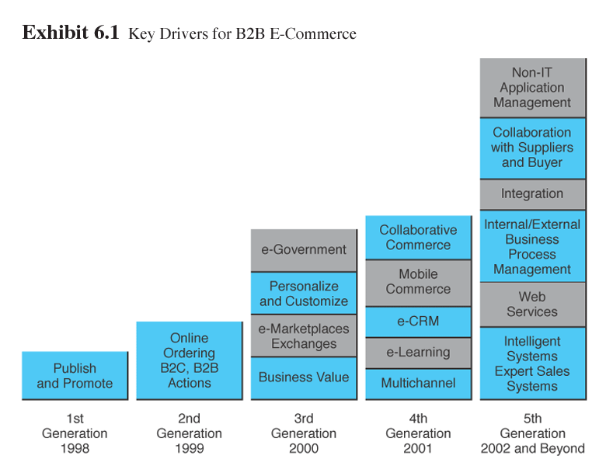
Concepts, Characteristics, and Models of B2B EC (cont.)

Slide 14
Concepts, Characteristics, and Models of B2B EC (cont.)
B2B characteristics
Parties to the transaction
Online intermediary: An online third party that brokers a transaction online between a buyer and a seller; can be virtual or click-and-mortar

Slide 15
Concepts, Characteristics, and Models of B2B EC (cont.)
Types of transactions
Spot buying: The purchase of goods and services as they are needed, usually at prevailing market prices
Strategic sourcing: Purchases involving long-term contracts that are usually based on private negotiations between sellers and buyers

Slide 16
B2B Characteristics (cont.)
Types of materials
Direct materials: Materials used in the production of a product (e.g., steel in a car or paper in a book)
Indirect materials: Materials used to support production (e.g., office supplies or light bulbs)
MROs (maintenance, repairs, and operations): Indirect materials used in activities that support production

Slide 17
Concepts, Characteristics, and Models of B2B EC (cont.)
Direction of trade
Vertical marketplaces: Markets that deal with one industry or industry segment (e.g., steel, chemicals)
Horizontal marketplaces: Markets that concentrate on a service, material, or a product that is used in all types of industries (e.g., office supplies, PCs)

Slide 18
Concepts, Characteristics, and Models of B2B EC (cont.)
Basic B2B transaction types
Sell-side
One seller to many buyers
Buy-side
One buyer from many sellers
Exchanges
Many sellers to many buyers
Collaborative commerce
Communication and sharing of information, design, and planning among business partners

Slide 19
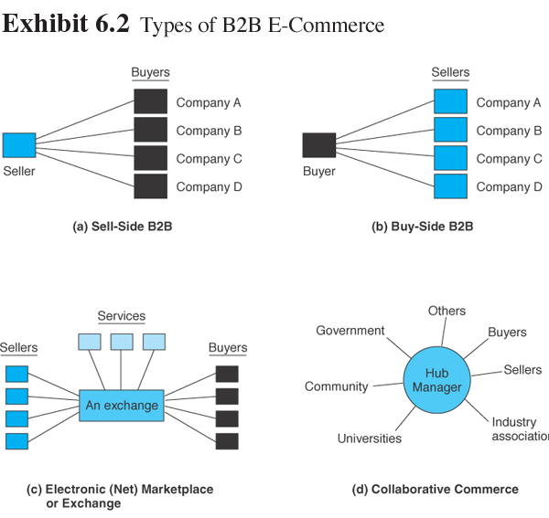
Concepts, Characteristics, and Models of B2B EC (cont.)

Slide 20
Concepts, Characteristics, and Models of B2B EC (cont.)
One-to-many and many-to-one: company-centric transactions
Company-centric EC: E-commerce that focuses on a single company’s buying needs (many-to-one, or buy-side) or selling needs (one-to-many, or sell-side)
Private e-marketplaces: Markets in which the individual sell-side or buy side company has complete control over participation in the selling or buying transaction

Slide 21
Concepts, Characteristics, and Models of B2B EC (cont.)
Many-to-many: exchanges
Exchanges (trading communities or trading exchanges): Many-to-many e-marketplaces, usually owned and run by a third party or a consortium, in which many buyers and many sellers meet electronically to trade with each other; also called trading communities or trading exchanges
Public e-marketplaces: Third-party exchanges that are open to all interested parties (sellers and buyers)

Slide 22
Concepts, Characteristics, and Models of B2B EC (cont.)
Collaborative commerce
Communication, design, planning, and information sharing among business partners

Slide 23
Concepts, Characteristics, and Models of B2B EC (cont.)
Supply chain relationships in B2B
Supply chain process consists of a number of interrelated subprocesses and roles
acquisition of materials from suppliers
processing of a product or service
packaging it and moving it to distributors and retailers
purchase of a product by the end consumer

Slide 24
Concepts, Characteristics, and Models of B2B EC (cont.)
B2B private e-marketplace provides a company with high supply chain power and high capabilities for online interactions
Joining a public e-marketplace provides a business with high buying and selling capabilities, but will result in low supply chain power
Companies that choose an intermediary to do their buying and selling will be low on both supply chain power and buying/selling capabilities

Slide 25
Concepts, Characteristics, and Models of B2B EC (cont.)
Virtual services industries in B2B
Travel services
Real estate
Financial services
Online stock trading
Online financing
Other online services

Slide 26
Concepts, Characteristics, and Models of B2B EC (cont.)
Benefits of B2B
Eliminates paper and reduces administrative costs.
Expedites cycle time
Lowers search costs and time for buyers
Increases productivity of employees dealing with buying and/or selling
Reduces errors and improves quality of services.
Reduces inventory levels and costs
Increases production flexibility, permitting just-in-time delivery
Facilitates mass customization
Increases opportunities for collaboration

Slide 27
One-to-Many: Sell-Side Marketplaces
Sell-side e-marketplace: A Web-based marketplace in which one company sells to many business buyers from e-catalogs or auctions, frequently over an extranet
Three major direct sales methods:
selling from electronic catalogs
selling via forward auctions
one-to-one selling

Slide 28
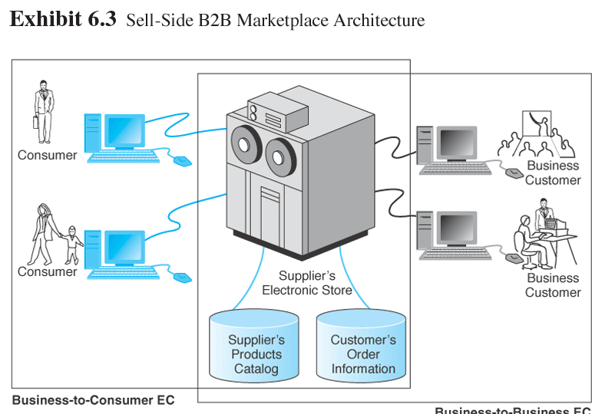
One-to-Many: Sell-Side Marketplaces (cont.)

Slide 29
One-to-Many: Sell-Side Marketplaces (cont.)
B2B sellers
click-and-mortar manufacturers or intermediaries, usually distributors or wholesalers
Customer service
online sellers can provide sophisticated customer services

Slide 30
Example: BigBoxx
Direct sales from catalogs
Bigboxx.com (bigboxx.com), based in Hong Kong, is a B2B retailer of office supplies
no physical stores and sells products through its online catalog
three types of customers:
large corporate clients
medium-sized corporate clients
small office/home offices (SOHO)
offers more than 10,000 items from 300 suppliers

Slide 31
Example: BigBoxx (cont.)
The company’s portal is attractive and easy to use
Has a tutorial that instructs users on how to use the Web site
Once registered, the user can start shopping using the online shopping cart
Users can look for items by browsing through the online catalog or by searching the site with a search engine

Slide 32
Example: BigBoxx (cont.)
Users can pay by cash or by check (upon delivery), via automatic bank drafts, by credit card, or by purchasing card.
Users will soon be able to pay through Internet-based direct debit, by electronic bill presentation and payment, or by Internet banking

Slide 33

Example: BigBoxx (cont.)
Using its own trucks and warehouses, Bigboxx.com makes deliveries within 24 hours or even on the same day
Delivery is scheduled online

Slide 34
Example: BigBoxx (cont.)
Value-added services for customers
check item availability in real time
track the status of each item in an order
promotions and suggested items based on customers’ user profiles
customized prices
control and central-approval features
automatic activation at desired time intervals of standing orders for repeat purchasing
a large number of Excel reports and data

Slide 35
One-to-Many: Sell-Side Marketplaces (cont.)
Configuration and customization
customize products
get price quotes
submit orders

Slide 36
One-to-Many: Sell-Side Marketplaces (cont.)
Major benefits of direct sales are:
Lower order-processing costs and less paperwork
A faster ordering cycle
Fewer errors in ordering and product configuration
Lower search costs of products for buyers
Lower search costs of finding buyers for sellers
Sellers can advertise and communicate online
Lower logistics costs
Ability to offer different catalogs and prices to different customers

Slide 37

Selling via Auctions
Using auctions on the sell side
Revenue generation
Cost savings
Increased page views
Member acquisition and retention

Slide 38
Selling via Auctions (cont.)
Selling from the company’s own site
The company will have to pay for infrastructure and operate and maintain the auction site
If then company already has an electronic marketplace for selling from e-catalogs, the additional cost may not be too high

Slide 39
Selling via Auctions (cont.)
Using intermediaries
An intermediary may conduct private auctions for a seller, either from the intermediary’s or the seller’s site
A company may choose to conduct auctions in a public marketplace, using a third-party hosting company

Slide 40
Using Intermediaries in Auctions (cont.)
Benefits of using intermediaries
no additional resources are required
auction set up to show the branding (company name) of the merchant rather than the intermediary’s name
intermediary does the work of:
controlling data on Web traffic, page views, and member registration
setting all the auction parameters (transaction fee structure, user interface, and reports)
integrating the information flow and logistics

Slide 41
Sell-Side Cases
Direct sales: Cisco Systems
World’s leading producer of routers, switches, and network interconnection services
Cisco’s portal began with technical support for customers and developed into one of the world’s largest direct sales EC sites

Slide 42
Sell-Side Cases (cont.)
Customer service
Applications offered:
software downloads
defect tracking
technical advice
85% of customer service inquiries and 95% of software updates are delivered online
Online ordering by customers
Provides online pricing and configuration tools to customers
98% are now placed through Cisco Connection Online (CCO)
Order status

Slide 43
Sell-Side Cases (cont.)
Benefits
Reduced operating costs for order taking
Enhanced technical support and customer service
Reduced technical support staff cost
Reduced software distribution costs
Faster service

Slide 44
Sell-Side Cases (cont.)
Sales through an intermediary: Marshall Industries (now Avnet.com)
large distributor of electronics components
known for its innovative use of information technologies and the Web

Slide 45
Sell-Side Cases (cont.)
Marshall Industries EC initiatives
MarshallNet
intranet that supports salespeople in the field via wireless devices and portable PCs
Marshall on the Internet (portal)
B2B portal for customers that offers information, ordering, and tracking capabilities
Strategic European Internet
strategic partner in Europe that offers MarshallNet in 17 languages

Slide 46
Sell-Side Cases (cont.)
Marshal Industries
Electronic Design Center
online configuration tool; provides technical specifications; offers simulation capabilities for making virtual components
PartnerNet
customized Web pages for major customers and suppliers
NetSeminar Education and News Portal
online training tool; brings suppliers and customers together for live interactions

Slide 47
Sell-Side Cases (cont.)
B2B intermediary: Boeing’s parts marketplace
World’s largest maker of airplanes for commercial and military customers
Major goal of Boeing’s intermediary parts market, called PART is supporting customers’ maintenance needs as a customer service

Slide 48
Sell-Side Cases (cont.)
Online strategy is to provide a single point of online access through which airlines (buyers) and the maintenance and parts providers (suppliers) can access data about the parts they need
Began using traditional EDI

Slide 49
Sell-Side Cases (cont.)
1996, Boeing introduced its PART page on the Internet
Customers around the world could
check parts availability and pricing
order parts
track order status
Less than a year later, about 50 percent of Boeing’s customers used PART for parts orders and customer service inquiries

Slide 50
Sell-Side Cases (cont.)
Boeing OnLine Data (BOLD) enables mechanics and technicians at the airport to access the technical manuals they need for repairs
These manuals are now available in digital form, and mechanics and technicians can access them via wireline or wireless devices

Slide 51
One-from-Many: Buy-Side Marketplaces and E-Procurement
Buy-side e-marketplace: A corporate-based acquisition site that uses reverse auctions, negotiations, group purchasing, or any other e-procurement method

Slide 52
One-from-Many: Buy-Side Marketplaces and E-Procurement (cont.)
Procurement methods
Buy from manufacturers, wholesalers, or retailers from their catalogs, and possibly by negotiation
Buy from the catalog of an intermediary that aggregates sellers’ catalogs or buy at industrial malls
Buy from an internal buyer’s catalog in which company-approved vendors’ catalogs, including agreed upon prices, are aggregated

Slide 53
One-from-Many: Buy-Side Marketplaces and E-Procurement (cont.)
Conduct bidding or tendering (a reverse auction) in a system where suppliers compete against each other
Buy at private or public auction sites in which the organization participates as one of the buyers
Join a group-purchasing system that aggregates participants’ demand, creating a large volume
Collaborate with suppliers to share information about sales and inventory, so as to reduce inventory and stock-outs and enhance just-in-time delivery

Slide 54
One-from-Many: Buy-Side Marketplaces and E-Procurement (cont.)
Inefficiencies in traditional procurement management
Procurement management: The coordination of all the activities relating to purchasing goods and services needed to accomplish the mission of an organization
Maverick buying: Unplanned purchases of items needed quickly, often at non-pre-negotiated, higher prices

Slide 55
One-from-Many: Buy-Side Marketplaces and E-Procurement (cont.)
e-procurement: The electronic acquisition of goods and services for organizations

Slide 56
Benefits of E-Procurement
Benefits of e-procurement
Increasing the productivity of purchasing agents
Lowering purchase prices through product standardization and consolidation of purchases
Improving information flow and management

Slide 57
Benefits of E-Procurement (cont.)
Minimizing the purchases made from noncontract vendors. Improving the payment process
Establishing efficient, collaborative supplier relations
Ensuring delivery on time, every time
Reducing the skill requirements and training needs of purchasing agents
Reducing the number of suppliers
Streamlining the purchasing process, making it simple and fast

Slide 58
Benefits of E-Procurement (cont.)
Reducing the administrative processing cost per order
Improved sourcing
Integrating the procurement process with budgetary control in an efficient and effective way
Minimizing human errors in the buying or shipping process
Monitoring and regulating buying behavior

Slide 59
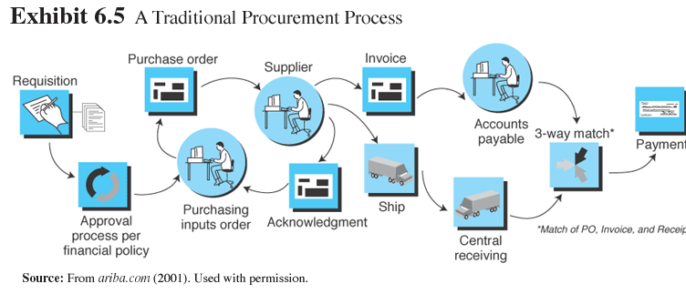
One-from-Many: Buy-Side Marketplaces and E-Procurement (cont.)

Slide 60
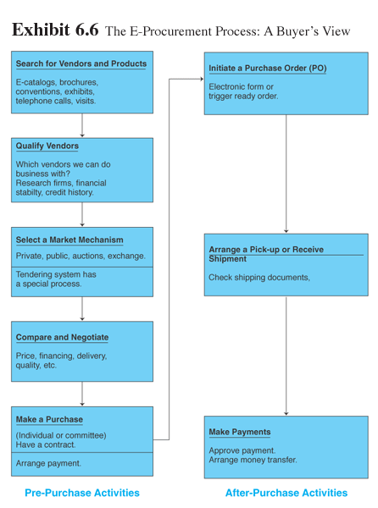
One-from-Many: Buy-Side Marketplaces and E-Procurement (cont.)

Slide 61
Implementing E-Procurement
Implementing e-procurement—major e-procurement implementation issues
Fitting e-procurement into the company EC strategy
Reviewing and changing the procurement process itself
Providing interfaces between
e-procurement with integrated enterprisewide information systems such as ERP or supply chain management (SCM)

Slide 62
Implementing E-Procurement (cont.)
Coordinating the buyer’s information system with that of the sellers; sellers have many potential buyers
Consolidating the number of regular suppliers to a minimum and assuring integration with their information systems, and if possible with their business processes

Slide 63
Buy-Side E-Marketplaces: Reverse Auctions
One of the major methods of e-procurement is through reverse auctions (tendering or bidding model)
request for quote (RFQ): The “invitation” to participate in a tendering (bidding) system
The reverse auction method is the most common model for large MRO purchases as it provides considerable savings

Slide 64
Reverse Auctions (cont.)
Conducting reverse auctions
Thousands of companies use the reverse auction model
They may be administered from a company’s Web site or from an intermediary’s site
The bidding process may last a day or more
Bidders may bid only once, but bidders can usually view the lowest bid and rebid several times

Slide 65
Reverse Auctions A Pioneer: General Electric’s TPN
Procurement revolution at GE—Trading Process Network (TPN) Post
With this online system, the sourcing department received the requisitions electronically from its internal customers and sent off a bid package to suppliers around the world via the Internet
The system automatically pulled the correct drawings and attached them to the electronic requisition forms

Slide 66
Reverse Auctions A Pioneer: General Electric’s TPN (cont.)
Benefits of TPN
labor involved in the procurement process declined by 30%
cut by 50% staff involved in the procurement process and redeployed those workers into other jobs
reduced the number of days to complete a contract by half
invoices were automatically reconciled with purchase orders
procurement departments around the world were able to share information about their best suppliers

Slide 67
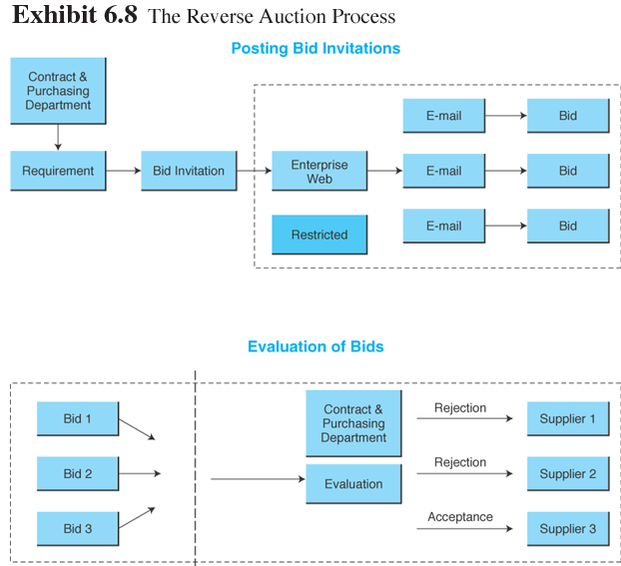
Reverse Auction: The Process

Slide 68
Reverse Auctions A Pioneer: General Electric’s TPN (cont.)
GXS Express Marketplaces is an expanded system that makes it a public posting place for other buyers
Suppliers gain instant access to global buyers
Dramatically improve the productivity of their bidding and sales activities
Increased sales volume
Expanded market reach and ability to find new buyers
Lower administration costs
Shorter requisition cycle time
Improved sales staff productivity
Streamlined bidding process

Slide 69
Other E-Procurement Methods
Internal marketplace: The aggregated catalogs of all approved suppliers combined into a single internal electronic catalog

Slide 70
Internal Marketplace (cont.)
Benefits of internal marketplaces
corporate buyers quickly find what they want, check availability and delivery times, and complete an electronic requisition form
reduce number of regular suppliers
easy financial controls

Slide 71
Internal Marketplace: Desktop Purchasing
Desktop purchasing: Direct purchasing from internal marketplaces without the approval of supervisors and without intervention of a procurement department
Desktop purchasing systems: Software that automates and supports purchasing operations for nonpurchasing professionals and casual end users

Slide 72
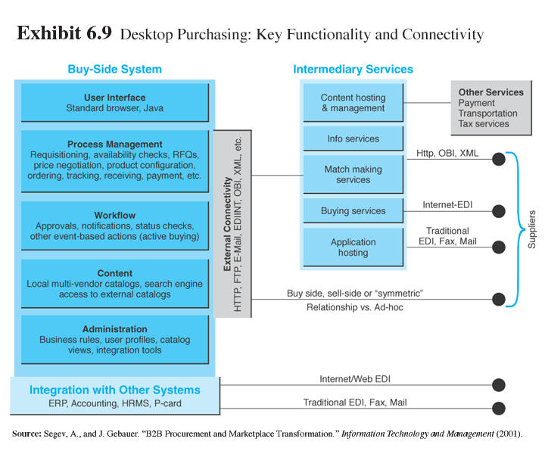
Other E-Procurement Methods (cont.)

Slide 73
Other E-Procurement Methods (cont.)
Industrial malls
Distributors that aggregate products from hundreds or thousands of suppliers in one place
Horizontal—carrying MRO (nonproduction) materials for use in a variety of industries
Vertical—carrying products used by one industry but at various segments of the supply chain

Slide 74
Other E-Procurement Methods (cont.)
E-auctions
sellers are increasingly motivated to sell surpluses and even regular products via auctions
e-auctions provide an opportunity to buyers to find inexpensive or unique items fairly quickly

Slide 75
Other E-Procurement Methods (cont.)
Group purchasing: The aggregation of orders from several buyers into volume purchases so that better prices can be negotiated

Slide 76
Other E-Procurement Methods (cont.)
Internal aggregation—companywide orders are aggregated using the Web and replenished automatically
External aggregation—provide SMEs with better prices, selection, and services by aggregating demand online and then either negotiating with suppliers or conducting reverse auctions

Slide 77
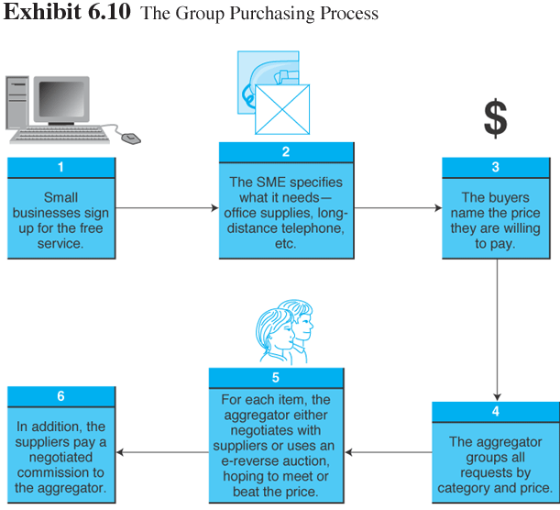
Other E-Procurement Methods (cont.)

Slide 78
Other E-Procurement Methods (cont.)
Purchasing direct goods
E-purchasing direct goods allows buyers to:
get them faster
reduce the unit cost
reduce inventories
avoid shortages of materials
expedite their own production processes

Slide 79
Other E-Procurement Methods (cont.)
Electronic bartering
Bartering exchange: An intermediary that links parties in a barter; a company submits its surplus to the exchange and receives points of credit, which can be used to buy the items that the company needs from other exchange participants

Slide 80
Infrastructure for B2B
Major infrastructures needed for B2B marketplaces
Telecommunications networks and protocols
Server(s) for hosting the databases and the applications
Software for various activities for executing the sell-side activities, buy-side activities, PRM, and building a storefront
Security for hardware and software

Slide 81
Other E-Procurement Methods (cont.)
Electronic data interchange (EDI): The electronic transfer of specially formatted standard business documents, such as bills, orders, and confirmations sent between business partners

Slide 82
Other E-Procurement Methods (cont.)
Value-added networks (VANs): Private, third-party managed networks that add communications services and security to existing common carriers; used to implement traditional EDI systems

Slide 83
Other E-Procurement Methods (cont.)
Web-based
EDI Services
Internet-based (Web) EDI: EDI that runs on the Internet and is widely accessible to most companies, including SMEs

Slide 84
Other E-Procurement Methods (cont.)
Integration
Integration with existing internal infrastructure and applications
EC applications of any kind need to be connected to the existing internal information systems
Integration with business partners
EC can be integrated more easily with internal systems than with external ones

Slide 85
Other E-Procurement Methods (cont.)
The role of standards and XML in B2B integration
XML (eXtensible Markup Language): Standard (and its variants) used to improve compatibility between the disparate systems of business partners by defining the meaning of data in business documents

Slide 86
Other E-Procurement Methods (cont.)
XML can overcome EDI barriers for three reasons:
XML is a flexible language, therefore it expands the rigid ranges of EDI
Message content can be easily read and understood by people using standard browsers
XML-based technologies require less-specialized skills

Slide 87
Other E-Procurement Methods (cont.)
Web services: An architecture enabling assembly of distributed applications from software services and tying them together

Slide 88
Managerial Issues
Can we justify the cost of B2B applications?
Which vendor(s) should we select?
Which B2B model(s) should we use?
Should we restructure our procurement system?

Slide 89
Managerial Issues (cont.)
What restructuring will be required for the shift to e-procurement?
What integration would be useful?
What are the ethical issues in B2B?
Will there be massive disintermediation?

Slide 90
Summary
The B2B field: EC activities between businesses
The major B2B models: sell-side; buy-side; trade exchanges; collaborative commerce
The characteristics of sell-side marketplaces: online direct sale by one seller to many buyers

Slide 91
Summary (cont.)
Sell-side intermediaries: provide value-added services to manufacturers and business customers
The characteristics of buy-side marketplaces and e-procurement: expedite purchasing, save on item and administrative costs, and gain better control over the purchasing process.

Slide 92
Summary (cont.)
B2B reverse auctions: tendering system used by buyers to collect bids electronically from suppliers
B2B aggregation and group purchasing: increasing the exposure and the bargaining power of companies can be done by aggregating either the buyers or the sellers.

Slide 93
Summary (cont.)
Infrastructure and standards in B2B: networks and protocols, multiple servers, application software, and security.
Web-based EDI, XML, and Web services: connectivity of B2B is facilitated by Web services.

Slide 94

Selesai

